Slide 1

DataDen: Introduction to APIs

Slide 2
Outline
Welcome to Workshop. Introduce Instructor
What are APIs? How do they work?
Use Cases for Web Scraping and APIs. Difference between the 2
Requesting API keys (Google Custom Search API, OpenAI API)
Live Coding Demo
Evaluation Form
Additional Learning Resources
API Projects I have worked on at CCSS.

Slide 3
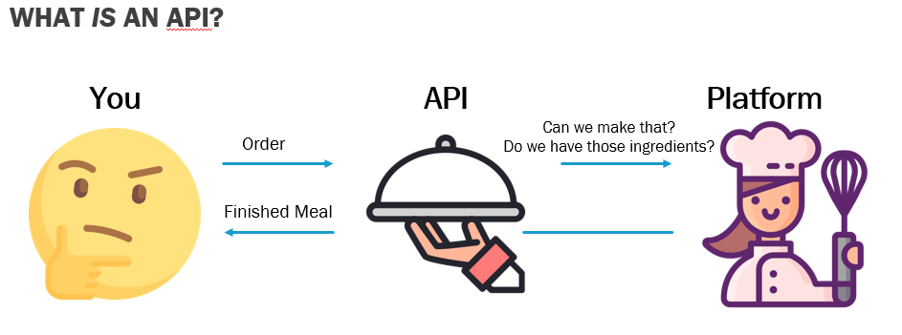
APIs
Allows communication and data exchange between 2 applications.
API Sample Data: https://jsonapi.org/examples/

Slide 4


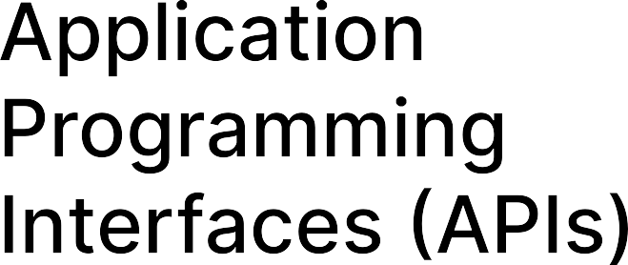
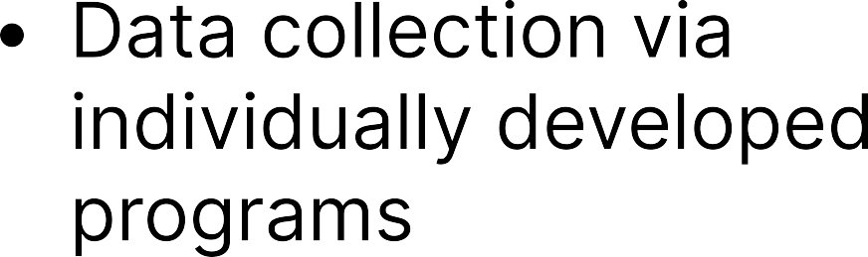






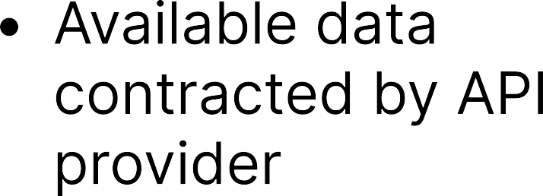
Web Scraping VS APIS

Slide 5
Coding Demo
Github Page. Sample code through Binder.
Running code through Binder

Slide 6
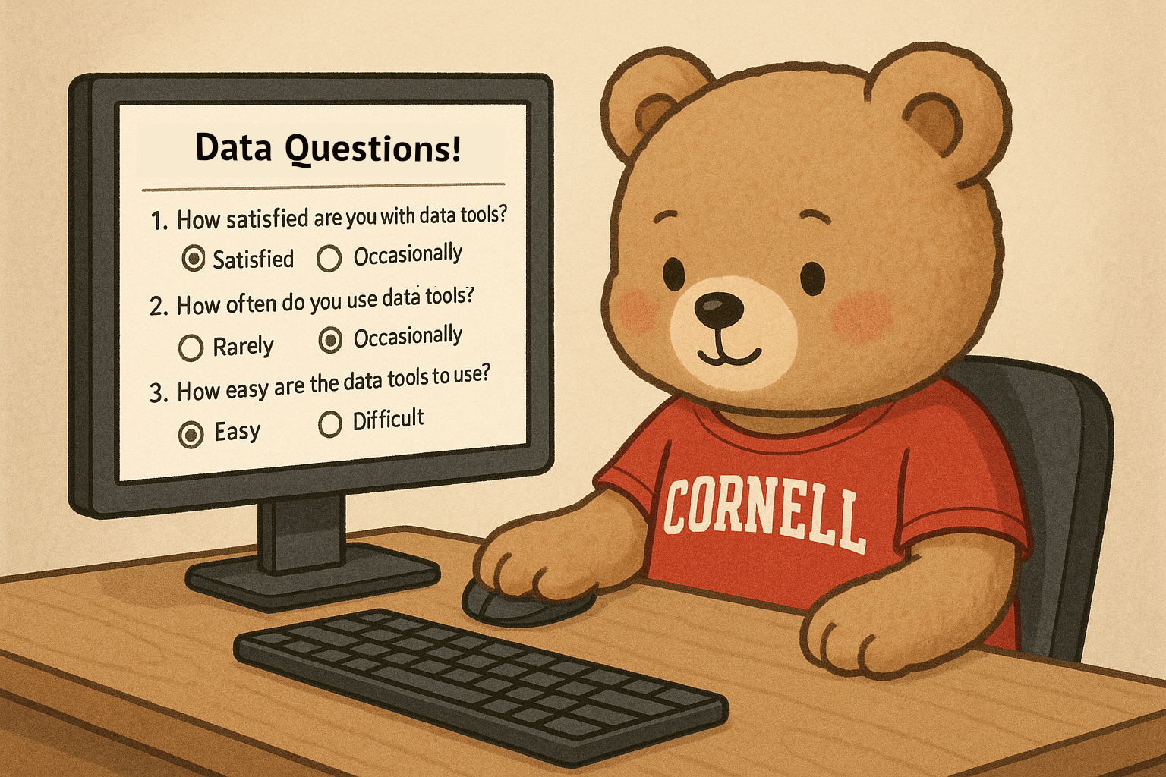
Please take a few seconds to give your feedback about this workshop!
bit.ly/3Zwqld5

Slide 7
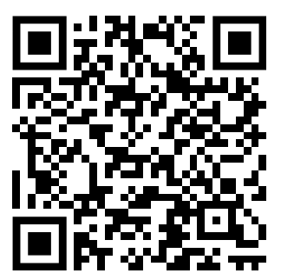
Additional Resources

Slide 8
